Slide 1
Clustering Highly Conserved Phylogenetic Markers
Christopher Hill
Advisor: Mihai Pop
Preliminary Exam
May 15th, 2014
Notes:
No guarantees
Arbitrary cutoffs

Slide 2
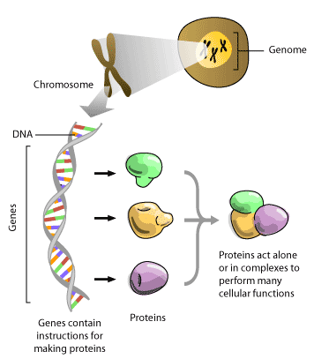

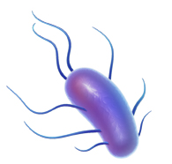
x 10¹³
x 10¹⁴
Bacteria
Wooley, John C., Adam Godzik, and Iddo Friedberg. "A primer on metagenomics." PLoS computational biology 6.2 (2010): e1000667.
http://www.3dscience.com/img/Products/Images/clip_art/bacteria_flagellae_web.jpg
http://www.scq.ubc.ca/wp-content/uploads/2006/08/molecular-machine.gif

Slide 3

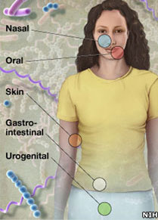
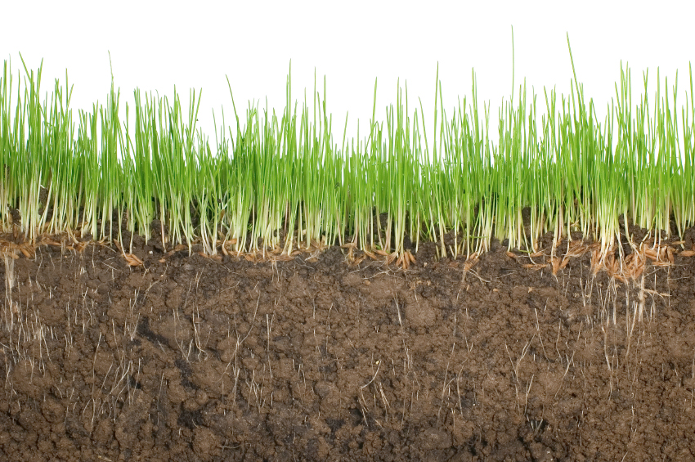
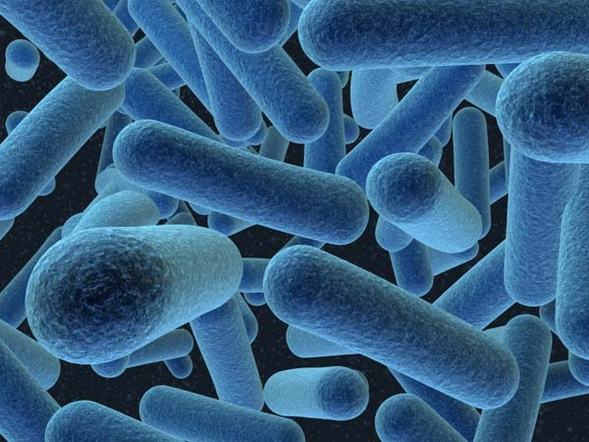
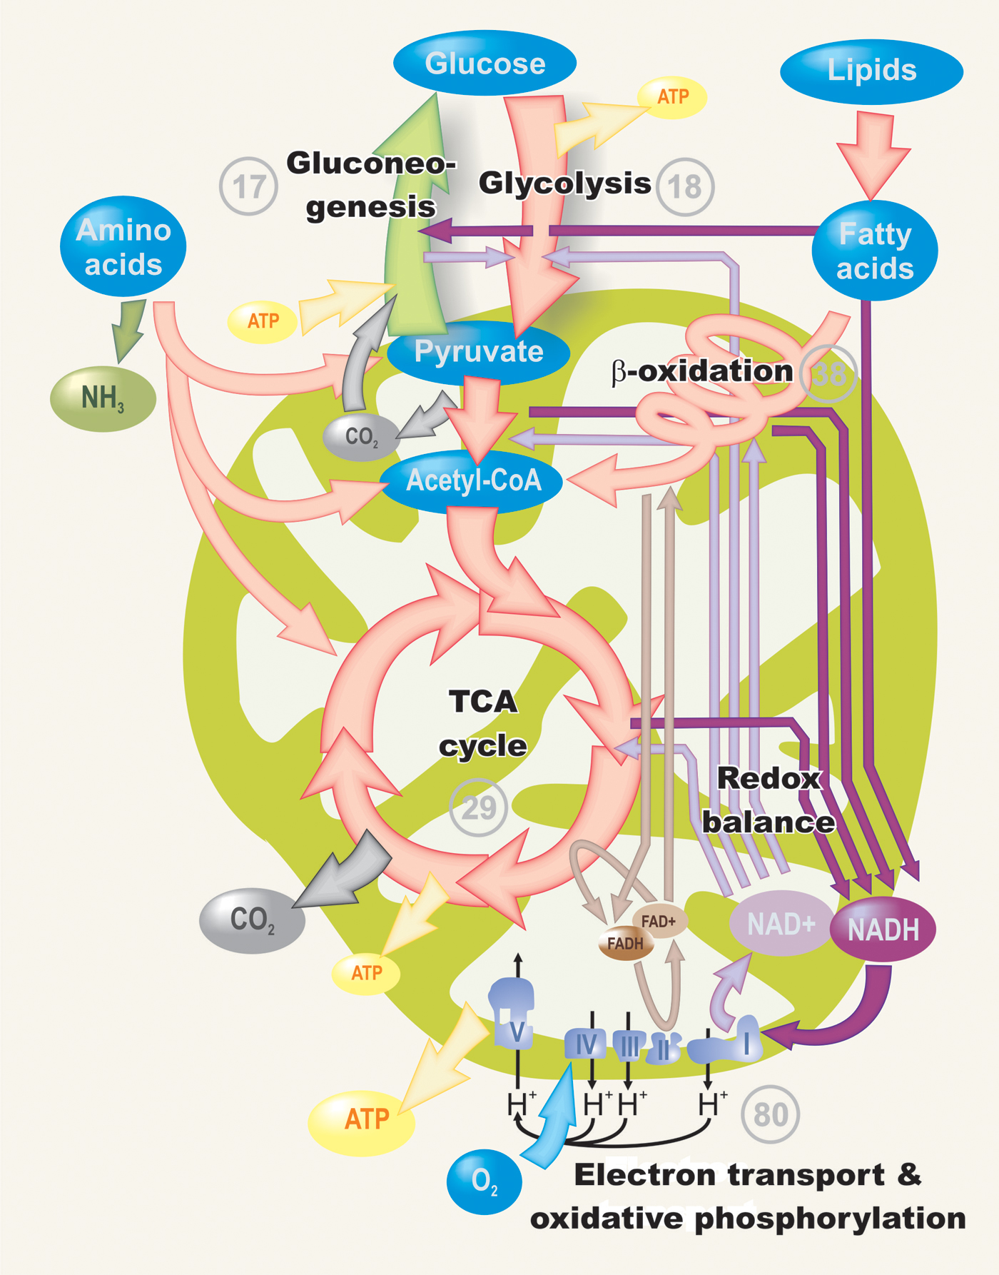
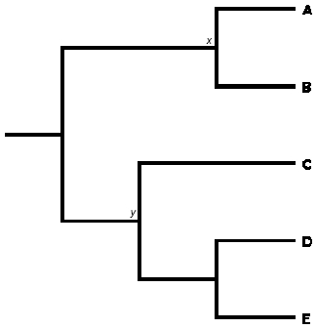
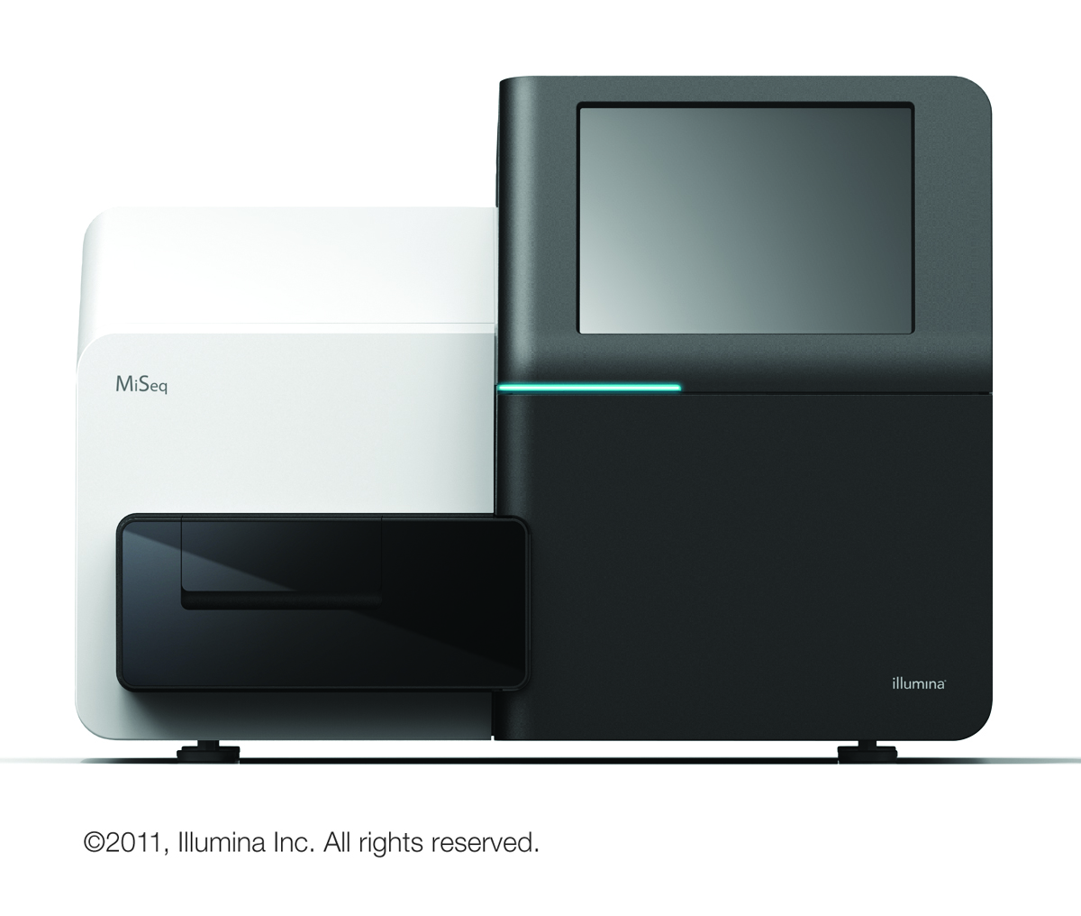
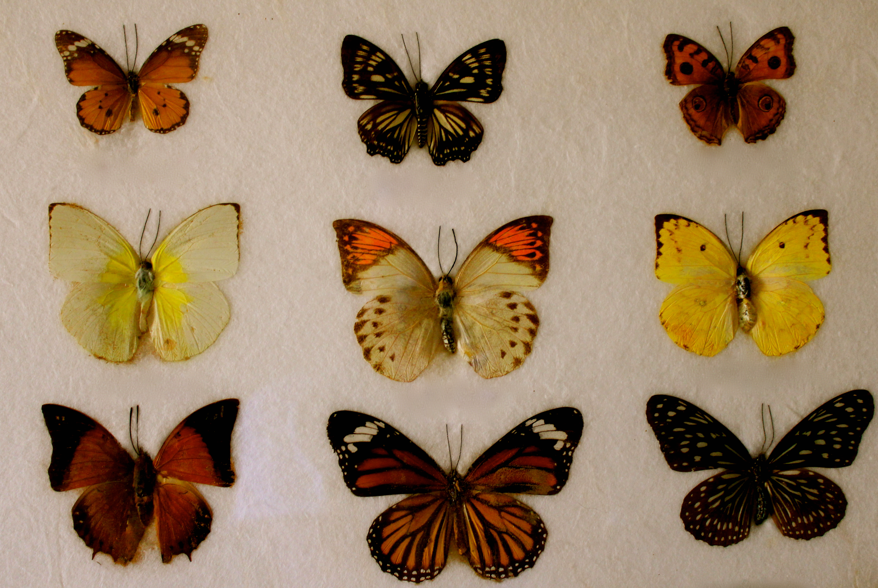
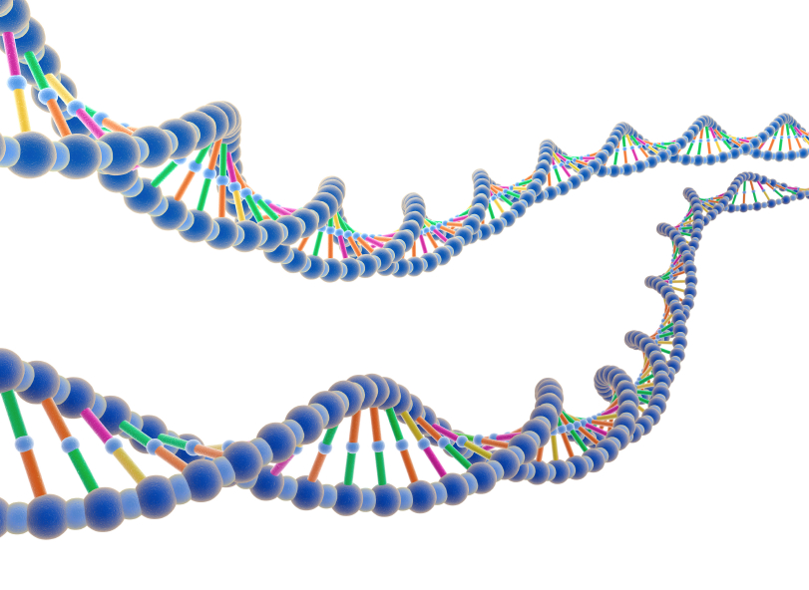
Environmental sample
Metagenomics
Filtering
>seq_1
ATCTGCTGGC
>seq_2
TTCTGGTACT
http://static.guim.co.uk/sys-images/Guardian/Pix/pictures/2012/9/26/1348685373327/Southern-Ocean-010.jpg
http://news.bbcimg.co.uk/media/images/60893000/jpg/_60893806_body.jpg
http://www.randyslawnservice.com/images/grass%20and%20soil.jpg
http://blogs.discovermagazine.com/loom/2010/03/04/i-for-one-welcome-our-microbial-overlords/#.U2vcMa1dWn0
http://blogs-images.forbes.com/matthewherper/files/2011/01/Illumina_MiSeqTM_CopyRight2011.jpg
http://ingridbrowning.com/wp-content/uploads/2011/08/IMG_3658.jpg
Sequencing
Analysis
Notes:
----- Meeting Notes (5/9/14 15:09) -----
De novo reference
How many different kinds of bacteria
Perfect world get whole sequence

Slide 4
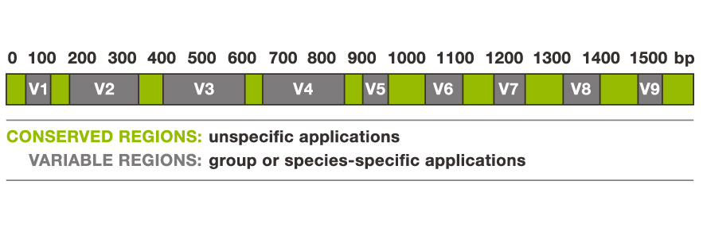
16S rRNA gene
AAATTGAAG..
Important for protein translation.
Found in most bacteria.
Online 16S databases:
SILVA
RDB
Greengenes
16S analysis pipelines:
Mothur (Schloss et al. 2009)
QIIME (Caporaso et al. 2010)
Tortoli, Enrico. "Impact of genotypic studies on mycobacterial taxonomy: the new mycobacteria of the 1990s." Clinical microbiology reviews 16.2 (2003): 319-354.
Notes:
Arbitrary cutoffs. 97% identity.
V1-V3.

Slide 5
Community
Targeted sequencing
Whole genome shotgun sequencing
Genomic DNA
Genomic DNA
Genomic DNA
Genomic DNA
Genomic DNA
Genomic DNA
Genomic DNA
Genomic DNA
Sequencing Error
http://www.alimetrics.net/en/images/stories/content/M_00-06%20DNA%20based%20kuva%203.jpg
Notes:
Green genes, silva
----- Meeting Notes (5/9/14 15:09) -----
Which regions we attend to use.
Characterize variable regions
Ill change the picture
V1-V3, V3-V5

Slide 6
Genomic DNA
Genomic DNA
Targeted sequencing
Whole genome shotgun sequencing
Genomic DNA
Genomic DNA
Genomic DNA
Genomic DNA
Genomic DNA
Genomic DNA
Genomic DNA
Genomic DNA
Sequencing Error
http://www.alimetrics.net/en/images/stories/content/M_00-06%20DNA%20based%20kuva%203.jpg
Notes:
Green genes, silva
----- Meeting Notes (5/9/14 15:09) -----
Which regions we attend to use.
Characterize variable regions
Ill change the picture
V1-V3, V3-V5

Slide 7
Sequencing Error
Species-specific SNP
x 6
x 3
Input
Cluster
Count

Slide 8
16S
16S
16S
…
16S
16S
16S
16S
16S
16S
16S
16S
16S
16S
16S
16S
16S
16S
16S
16S
16S
16S
16S
16S rRNA targeted sequencing
Whole genome shotgun (WGS)
sequencing
Notes:
----- Meeting Notes (5/9/14 15:09) -----
Coverage can't assemble
Objective,

Slide 9

Part I: Fast k-difference alignment
X 100,000,000
Part 2: Multi-core clustering
Part 3: Ambiguous assignment
?

Slide 10
Clustering
Notes:
----- Meeting Notes (5/9/14 15:09) -----
Population, clustering differences, why cluster 16s

Slide 11
Hierarchical clustering
Divisive
(Top-down)
Agglomerative
(Bottom-up)
All objects in one cluster.
Iteratively split clusters.
All objects in own cluster.
Iteratively merge clusters.
Before:
After:
ESPRIT-Tree (Sun et al. 2011)
HPC-CLUST (Rodrigues et al. 2014)
Often O(n³) time, but more efficient algorithms exist.
Notes:
----- Meeting Notes (5/9/14 15:09) -----
Three different shapes

Slide 12
Hierarchical clustering
Divisive
(Top-down)
Agglomerative
(Bottom-up)
Often O(n³) time, but more efficient algorithms exist.
Notes:
----- Meeting Notes (5/9/14 15:09) -----
Three different shapes

Slide 13
Greedy clustering
1. Select a cluster center.
3. Repeat until no more
sequences remain.
2. Recruit sequences to center.
Any sequence within a specified edit distance or similarity from the cluster center is recruited by the cluster center.

Slide 14
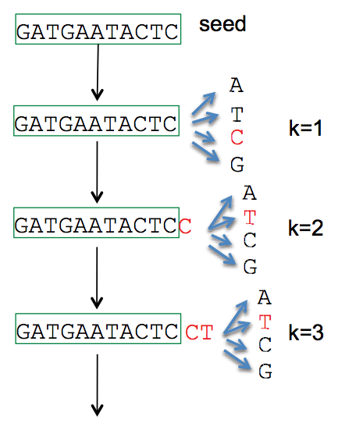
1. Select a cluster center.
Length | Abundance | k-mers
Longest remaining sequence
Run fast deduplication
…
CD-HIT (Li et al. 2006)
UCLUST (Edgar 2010) DNACLUST (Ghodsi et al. 2011)
UCLUST (Edgar 2010)
AbundantOTU (Ye 2010)

Slide 15
2. Recruit sequences to center.
Edit (Levenshtein) distance
Similarity
ATGTGA
x|||x|
-TGTCA
Substitutions, insertions, deletions
K-mer distance
k=2 AA AC AG AT .. TG TT
ATGTGA: [0 0 0 1 .. 2 0]
-TGTCA: [0 0 0 0 .. 1 0]
Notes:
Fractional common k-mer count: For the last measure, the distance is computed based on the minimum count of every k-mer in the two sequences, thus if two sequences are very different, the minimums will all be small.
Identiy
----- Meeting Notes (5/9/14 15:09) -----
Characters
TGTG - 2
Add gap character
Distances
challenges

Slide 16
How to calculate edit distance between:
AGGTATCGC and ATGGC?
Problem
Dynamic programming
Solution

Slide 17
Break down problem into easier sub-problems
Dynamic Programming
M(n,m) – Table storing solutions to sub-problems for aligning pattern and the text of lengths n and m, respectively.
Text (t)
 |  | 0 | 1 | 2 | 3 | 4 | 5 | 6 | 7 | 8 | 9
 | M | - | A | G | G | T | A | T | C | G | C
0 | - | 0 | 1 | 2 | 3 | 4 | 5 | 6 | 7 | 8 | 9
1 | A | 1
2 | T | 2
3 | G | 3
4 | G | 4
5 | C | 5
Pattern (p)
M(i,j) – minimum edit distance of aligning pattern_{0..i} to text_{0..j}
Compute M(i,j) using previously computed smaller values!
Notes:
----- Meeting Notes (5/9/14 15:09) -----
Subproblems have a specific set
Recursively

Slide 18
Text (t)
 |  | 0 | 1 | 2 | 3 | 4 | 5 | 6 | 7 | 8 | 9
 | M | - | A | G | G | T | A | T | C | G | C
0 | - | 0 | 1 | 2 | 3 | 4
1 | A | 1 | 0 | 1 | 2 | 3
2 | T | 2 | 1 | 1 | 2 | ?
3 | G | 3 | 2 | 1 | 1
4 | G | 4 | 3 | 2 | 1
5 | C | 5 | 4 | 3 | 2
Pattern (p)
AGGT
A-T-
Align p_{0..2} to t_{0..3} + gap in p
M(2,4) =
min
AGGT-
A---T
Align p_{0..1} to t_{0..4} + gap in t
Align p_{0..1} to t_{0..3} + cost(‘T’,’T’)
AGGT
A--T
M(2,4) =
2

Slide 19
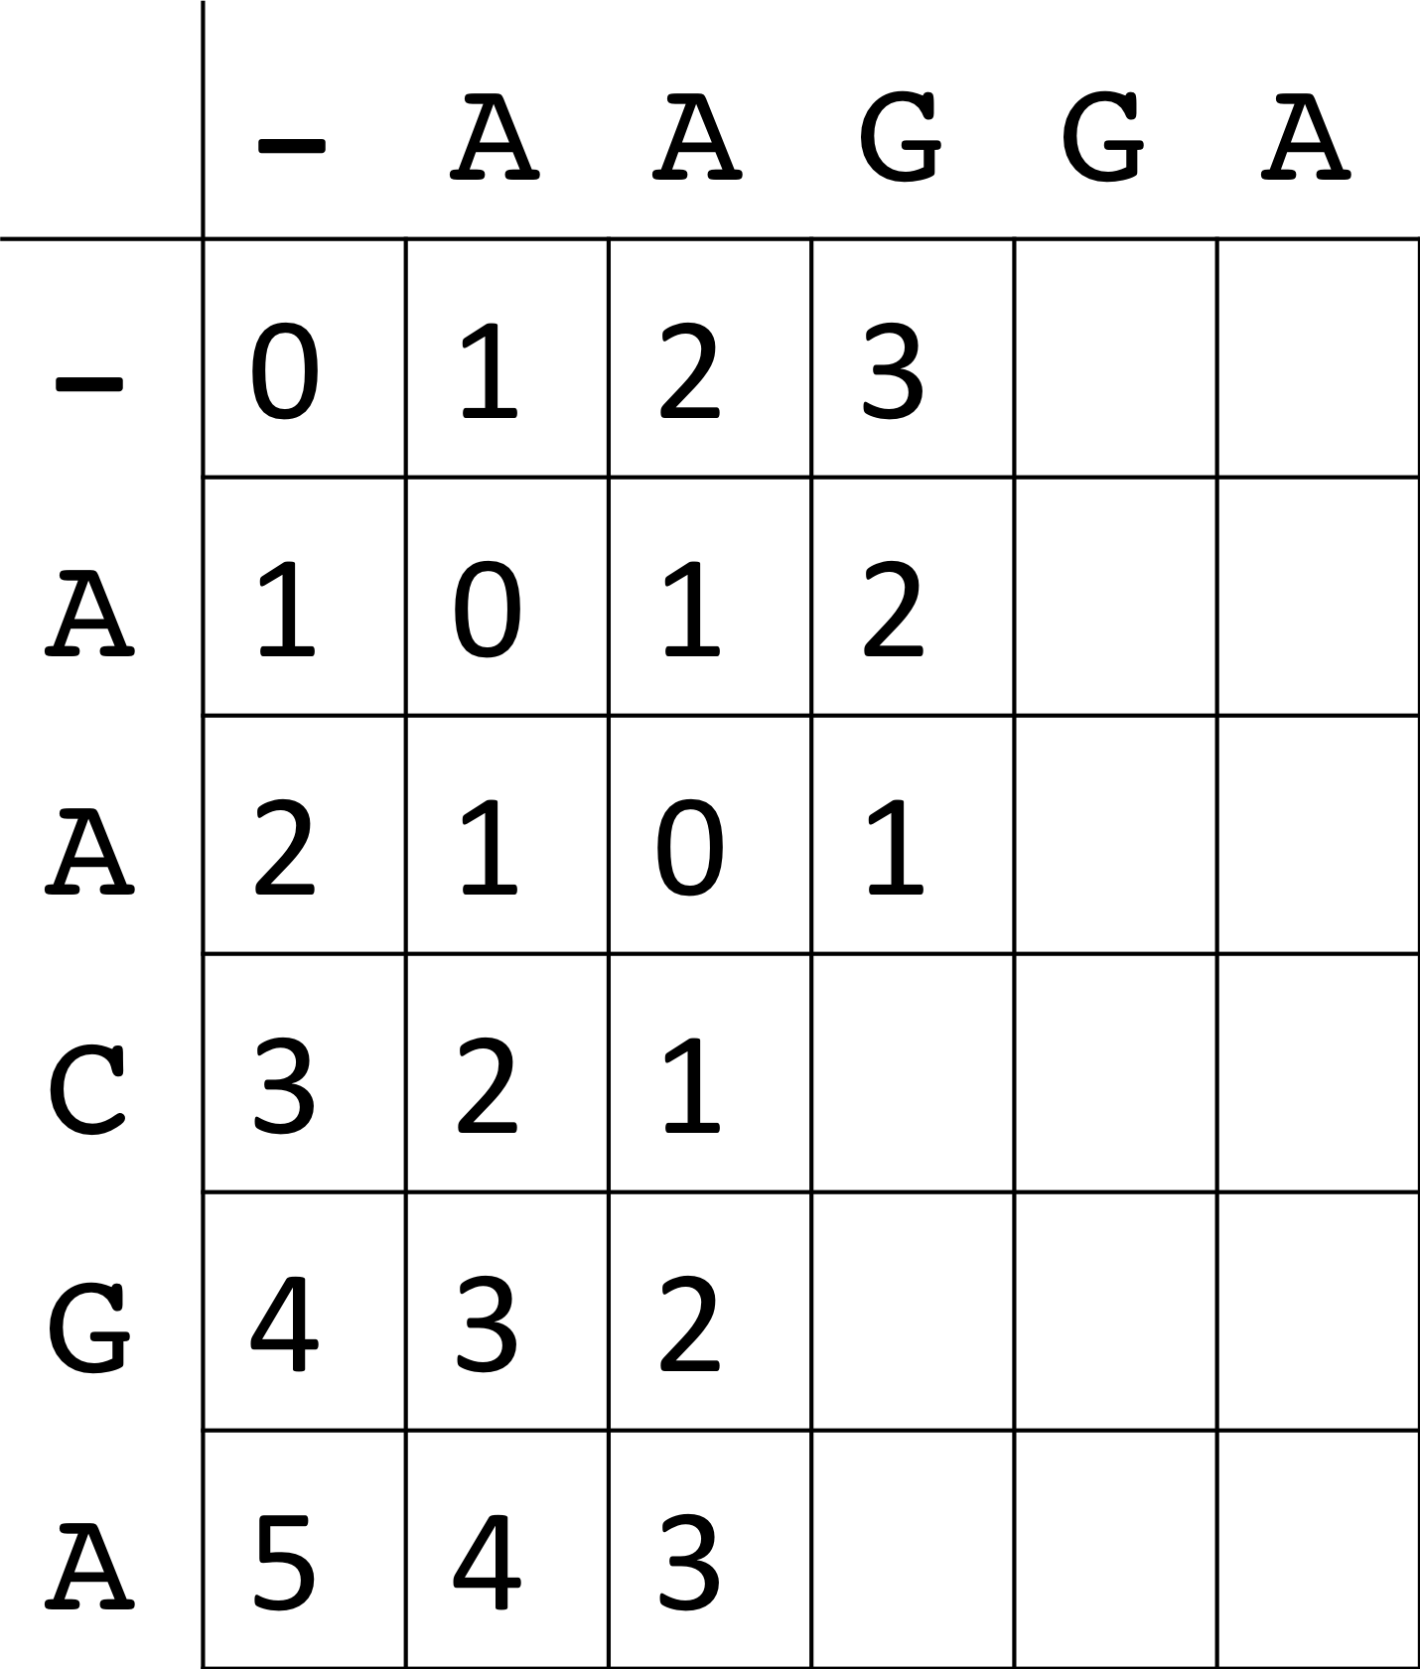
d
q
Optimal edit distance will
be located M_{ij}
O(n*m) time and memory
Notes:
----- Meeting Notes (5/9/14 15:09) -----
levenstein distance
M_nm

Slide 20
Global alignment
Semi-global alignment
 |  | 0 | 1 | 2 | 3 | 4 | 5 | 6 | 7 | 8 | 9
 | M | - | A | G | G | T | A | T | C | G | C
0 | - | 0 | 1 | 2 | 3 | 4 | 5 | 6 | 7 | 8 | 9
1 | A | 1 | 0 | 1 | 2 | 3 | 4 | 5 | 6 | 7 | 8
2 | T | 2 | 1 | 1 | 2 | 2 | 3 | 4 | 5 | 6 | 7
3 | G | 3 | 2 | 1 | 1 | 2 | 3 | 4 | 5 | 5 | 6
4 | G | 4 | 3 | 2 | 1 | 2 | 3 | 4 | 5 | 5 | 6
5 | C | 5 | 4 | 3 | 2 | 2 | 3 | 4 | 4 | 5 | 5
 |  | 0 | 1 | 2 | 3 | 4 | 5 | 6 | 7 | 8 | 9
 | M | - | A | G | G | T | A | T | C | G | C
0 | - | 0 | 0 | 0 | 0 | 0 | 0 | 0 | 0 | 0 | 0
1 | A | 1 | 0 | 1 | 1 | 1 | 0 | 1 | 1 | 1 | 1
2 | T | 2 | 1 | 1 | 2 | 1 | 1 | 0 | 1 | 2 | 2
3 | G | 3 | 2 | 1 | 1 | 2 | 2 | 1 | 1 | 1 | 2
4 | G | 4 | 3 | 2 | 1 | 2 | 3 | 2 | 2 | 1 | 2
5 | C | 5 | 4 | 3 | 2 | 2 | 3 | 3 | 2 | 2 | 1
AGGTATCGC
|x|xxxx||
ATG----GC
AGGTATCGC
||x||
----ATGGC
O(n*m) time and memory
Notes:
----- Meeting Notes (5/9/14 15:09) -----
highly conservative markers - 16s

Slide 21
What if we want to limit the amount of edits?
For example, k = 2?
Global alignment
Semi-global alignment
 |  | 0 | 1 | 2 | 3 | 4 | 5 | 6 | 7 | 8 | 9
 | M | - | A | G | G | T | A | T | C | G | C
0 | - | 0 | 1 | 2 | 3 | 4 | 5 | 6 | 7 | 8 | 9
1 | A | 1 | 0 | 1 | 2 | 3 | 4 | 5 | 6 | 7 | 8
2 | T | 2 | 1 | 1 | 2 | 2 | 3 | 4 | 5 | 6 | 7
3 | G | 3 | 2 | 1 | 1 | 2 | 3 | 4 | 5 | 5 | 6
4 | G | 4 | 3 | 2 | 1 | 2 | 3 | 4 | 5 | 5 | 6
5 | C | 5 | 4 | 3 | 2 | 2 | 3 | 4 | 4 | 5 | 5
 |  | 0 | 1 | 2 | 3 | 4 | 5 | 6 | 7 | 8 | 9
 | M | - | A | G | G | T | A | T | C | G | C
0 | - | 0 | 0 | 0 | 0 | 0 | 0 | 0 | 0 | 0 | 0
1 | A | 1 | 0 | 1 | 1 | 1 | 0 | 1 | 1 | 1 | 1
2 | T | 2 | 1 | 1 | 2 | 1 | 1 | 0 | 1 | 2 | 2
3 | G | 3 | 2 | 1 | 1 | 2 | 2 | 1 | 1 | 1 | 2
4 | G | 4 | 3 | 2 | 1 | 2 | 3 | 2 | 2 | 1 | 2
5 | C | 5 | 4 | 3 | 2 | 2 | 3 | 3 | 2 | 2 | 1
O(k*n) time and memory
O(n*m) time and memory!
Notes:
----- Meeting Notes (5/9/14 15:09) -----
Philosophical, time

Slide 22
Part I: Fast k-difference alignment
Proposed work:
Replace standard edit distance calculation with Landau-Vishkin algorithm.
Modify Landau-Vishkin algorithm to reuse sorted sequence database.

Slide 23
Landau-Vishkin k-difference algorithm
Traditional dynamic programming table
 |  | 0 | 1 | 2 | 3 | 4 | 5 | 6 | 7 | 8 | 9
 | M | - | A | G | G | T | A | T | C | G | C
0 | - | 0 | 0 | 0 | 0 | 0 | 0 | 0 | 0 | 0 | 0
1 | A | 1 | 0 | 1 | 1 | 1 | 0 | 1 | 1 | 1 | 1
2 | T | 2 | 1 | 1 | 2 | 1 | 1 | 0 | 1 | 2 | 2
3 | G | 3 | 2 | 1 | 1 | 2 | 2 | 1 | 1 | 1 | 2
4 | G | 4 | 3 | 2 | 1 | 2 | 3 | 2 | 2 | 1 | 2
5 | C | 5 | 4 | 3 | 2 | 2 | 3 | 3 | 2 | 2 | 1
Intuition: For each diagonal in M, store the last column before the edit number changes.
C(e,d) = last column in M on d-diagonal that contains e edits.
C(0,2) = 2
d = 2
Alternate dynamic programming table
 |  |  |  |  |  |  | d
 | C | -3 | -2 | -1 | 0 | 1 | 2 | 3 | 4 | 5 | 6 | 7
 | -1 |  |  | -∞ | -1 | 0 | 1 | 2 | 3 | 4 | 5 | 6
 | 0 |  | -∞ | -1 | 1 | 1 | 2 | 3 | 6 | 5 | 6
e | 1 | -∞ | -1 | 3 | 3 | 2 | 4 | 6 | 9 | 8
 | 2 | -1 | 3 | 4 | 4 | 4 | 7 | 8 | 9

Slide 24
Landau-Vishkin k-difference algorithm
Traditional dynamic programming table
 |  | 0 | 1 | 2 | 3 | 4 | 5 | 6 | 7 | 8 | 9
 | M | - | A | G | G | T | A | T | C | G | C
0 | - | 0 | 0 | 0 | 0 | 0 | 0 | 0 | 0 | 0 | 0
1 | A | 1 | 0 | 1 | 1 | 1 | 0 | 1 | 1 | 1 | 1
2 | T | 2 | 1 | 1 | 2 | 1 | 1 | 0 | 1 | 2 | 2
3 | G | 3 | 2 | 1 | 1 | 2 | 2 | 1 | 1 | 1 | 2
4 | G | 4 | 3 | 2 | 1 | 2 | 3 | 2 | 2 | 1 | 2
5 | C | 5 | 4 | 3 | 2 | 2 | 3 | 3 | 2 | 2 | 1
Intuition: For each diagonal in M, store the last column before the edit number changes.
C(e,d) = last column in M on d-diagonal that contains e edits.
C(1,2) = 4
d = 2
Alternate dynamic programming table
 |  |  |  |  |  |  | d
 | C | -3 | -2 | -1 | 0 | 1 | 2 | 3 | 4 | 5 | 6 | 7
 | -1 |  |  | -∞ | -1 | 0 | 1 | 2 | 3 | 4 | 5 | 6
 | 0 |  | -∞ | -1 | 1 | 1 | 2 | 3 | 6 | 5 | 6
e | 1 | -∞ | -1 | 3 | 3 | 2 | 4 | 6 | 9 | 8
 | 2 | -1 | 3 | 4 | 4 | 4 | 7 | 8 | 9

Slide 25
Landau-Vishkin k-difference algorithm
Traditional dynamic programming table
 |  | 0 | 1 | 2 | 3 | 4 | 5 | 6 | 7 | 8 | 9
 | M | - | A | G | G | T | A | T | C | G | C
0 | - | 0 | 0 | 0 | 0 | 0 | 0 | 0 | 0 | 0 | 0
1 | A | 1 | 0 | 1 | 1 | 1 | 0 | 1 | 1 | 1 | 1
2 | T | 2 | 1 | 1 | 2 | 1 | 1 | 0 | 1 | 2 | 2
3 | G | 3 | 2 | 1 | 1 | 2 | 2 | 1 | 1 | 1 | 2
4 | G | 4 | 3 | 2 | 1 | 2 | 3 | 2 | 2 | 1 | 2
5 | C | 5 | 4 | 3 | 2 | 2 | 3 | 3 | 2 | 2 | 1
Intuition: For each diagonal in M, store the last column before the edit number changes.
C(e,d) = last column in M on d-diagonal that contains e edits.
C(2,2) = 7
d = 2
Alternate dynamic programming table
 |  |  |  |  |  |  | d
 | C | -3 | -2 | -1 | 0 | 1 | 2 | 3 | 4 | 5 | 6 | 7
 | -1 |  |  | -∞ | -1 | 0 | 1 | 2 | 3 | 4 | 5 | 6
 | 0 |  | -∞ | -1 | 1 | 1 | 2 | 3 | 6 | 5 | 6
e | 1 | -∞ | -1 | 3 | 3 | 2 | 4 | 6 | 9 | 8
 | 2 | -1 | 3 | 4 | 4 | 4 | 7 | 8 | 9
O(k*m) time and memory!

Slide 26
Alternate dynamic programming table
 |  |  |  |  |  |  | d
 | C | -3 | -2 | -1 | 0 | 1 | 2 | 3 | 4 | 5 | 6 | 7
 | -1 |  |  | -∞ | -1 | 0 | 1 | 2 | 3 | 4 | 5 | 6
 | 0 |  | -∞ | -1 | 1 | 1 | 2 | 3 | 6 | 5 | 6
e | 1 | -∞ | -1 | 3 | 3 | 2 | 4 | 6 | 9 | 8
 | 2 | -1 | 3 | 4 | 4 | 4 | 7 | 8 | 9

Slide 27
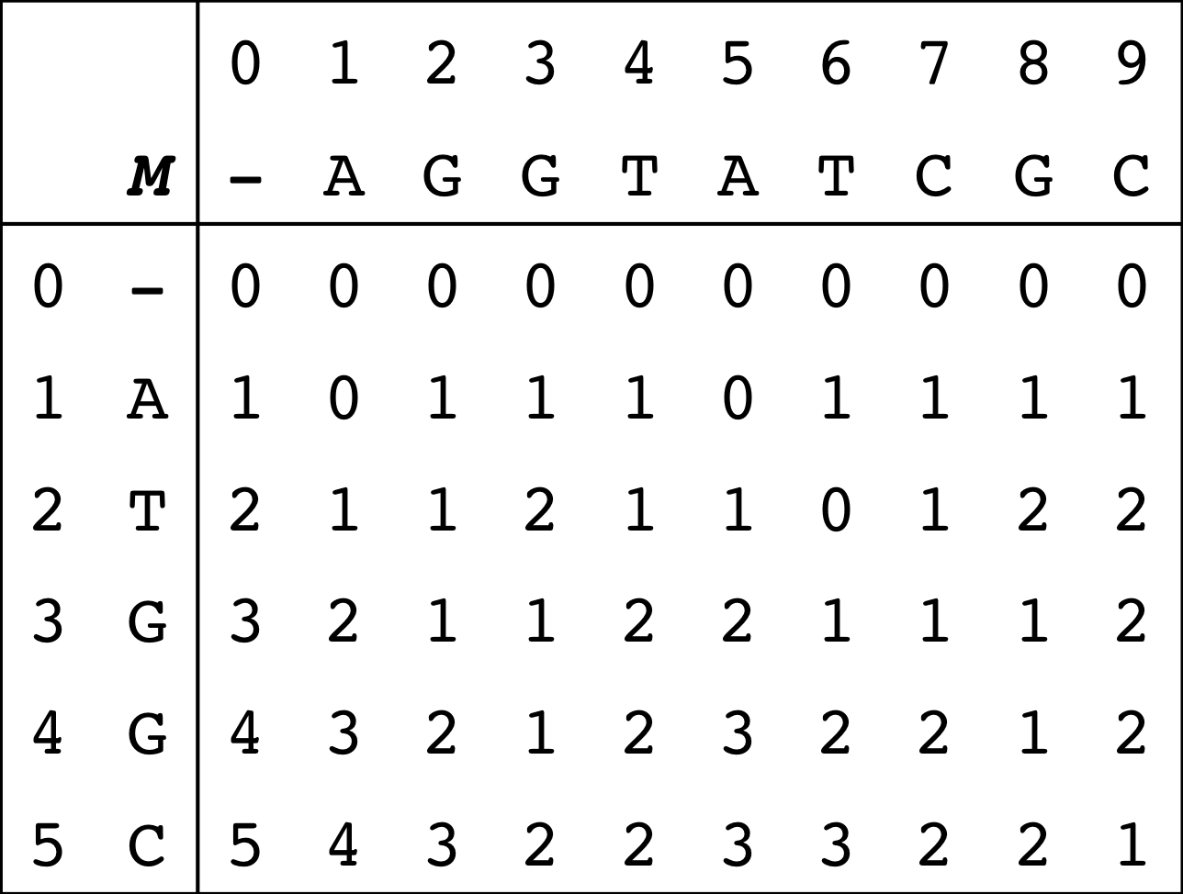
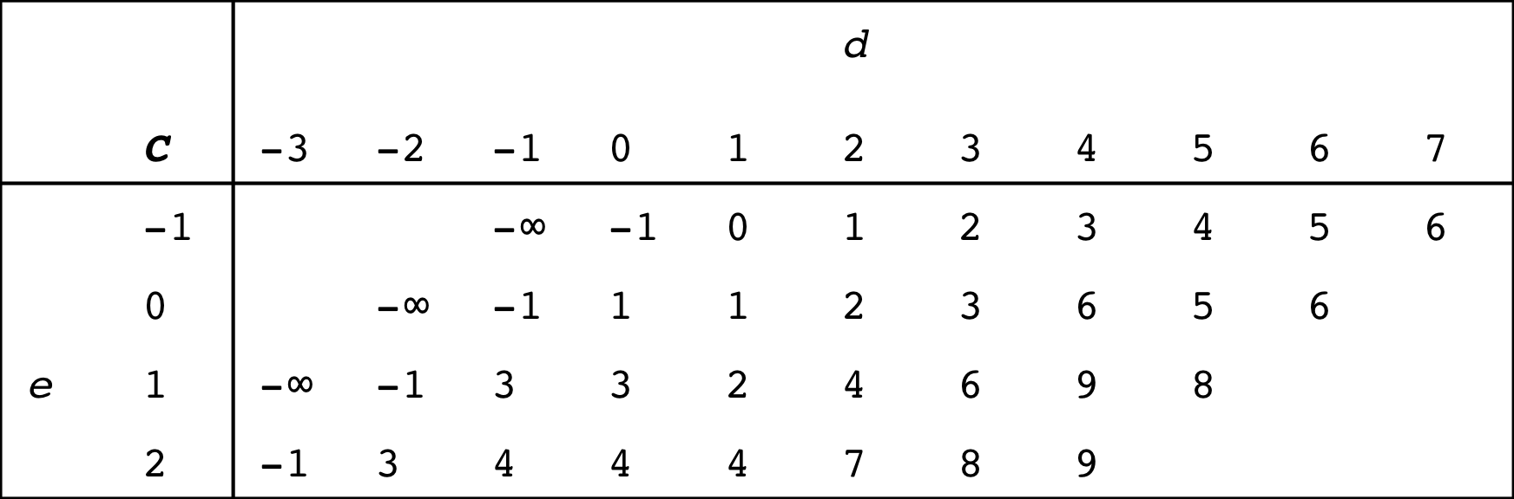
Traditional dynamic programming table
Semi-global alignment
Alternate dynamic programming table
C(e,d) = last column in M on d-diagonal that contains e edits.
C(1,2) = 1
d = 2
O(k*m) time*
and memory!
Notes:
----- Meeting Notes (5/9/14 15:09) -----
red square wrong
edit distance
c(1,2) = 4

Slide 28
TODO: Farthest reaching d-path
Explain Landau-Vishkin algorithm
How to fill out the matrix

Slide 29
Preliminary Results
Dataset:
1,000 randomly sampled 16S rRNA sequences from HMP (600-300bp).
Center:
Randomly select 10 sequences to serve as centers.
 | Semi-global (k=5)
Naïve | 1.102 sec
Landau-Vishkin | 0.0332 sec
Speedup | 33.2x
Runtimes averaged over 100 runs.
Notes:
Next steps.

Slide 30
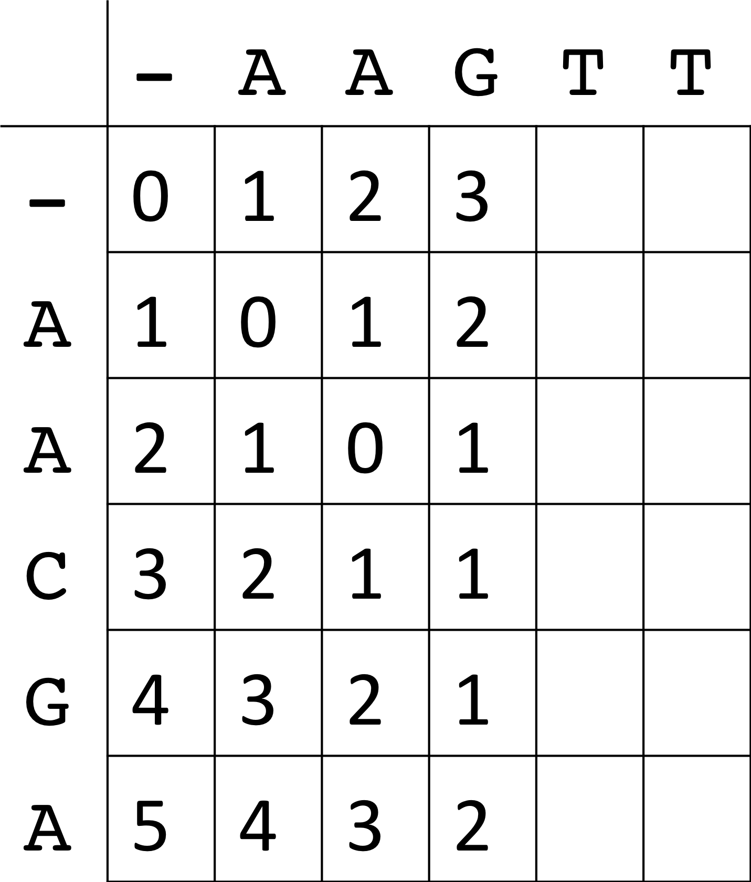
d1
d2
q
q
In DNACLUST, sequences are stored sorted so we can reuse parts from the previous dynamic programming table.

Slide 31
In DNACLUST, sequences are stored sorted so we can reuse parts from the previous dynamic programming table.
 |  | 0 | 1 | 2 | 3 | 4 | 5 | 6 | 7 | 8 | 9
 | M | - | A | G | G | T | A | T | C | G | C
0 | - | 0 | 0 | 0 | 0 | 0 | 0 | 0 | 0 | 0 | 0
1 | A | 1 | 0 | 1 | 1 | 1 | 0 | 1 | 1 | 1 | 1
2 | T | 2 | 1 | 1 | 2 | 1 | 1 | 0 | 1 | 2 | 2
3 | G | 3 | 2 | 1 | 1 | 2 | 2 | 1 | 1 | 1 | 2
4 | G | 4 | 3 | 2 | 1 | 2 | 3 | 2 | 2 | 1 | 2
5 | C | 5 | 4 | 3 | 2 | 2 | 3 | 3 | 2 | 2 | 1
 |  | 0 | 1 | 2 | 3 | 4 | 5 | 6 | 7 | 8 | 9
 | M | - | A | G | G | T | A | T | C | G | C
0 | - | 0 | 0 | 0 | 0 | 0 | 0 | 0 | 0 | 0 | 0
1 | A | 1 | 0 | 1 | 1 | 1 | 0 | 1 | 1 | 1 | 1
2 | T | 2 | 1 | 1 | 2 | 1 | 1 | 0 | 1 | 2 | 2
3 | T
4 | A
5 | A
Previous sequence: ATGGC
New sequence: ATTAA
Longest common prefix: 2
Notes:
Traditional table

Slide 32
 |  | 0 | 1 | 2 | 3 | 4 | 5 | 6 | 7 | 8 | 9
 | M | - | A | G | G | T | A | T | C | G | C
0 | - | 0 | 0 | 0 | 0 | 0 | 0 | 0 | 0 | 0 | 0
1 | A | 1 | 0 | 1 | 1 | 1 | 0 | 1 | 1 | 1 | 1
2 | T | 2 | 1 | 1 | 2 | 1 | 1 | 0 | 1 | 2 | 2
3 | G | 3 | 2 | 1 | 1 | 2 | 2 | 1 | 1 | 1 | 2
4 | G | 4 | 3 | 2 | 1 | 2 | 3 | 2 | 2 | 1 | 2
5 | C | 5 | 4 | 3 | 2 | 2 | 3 | 3 | 2 | 2 | 1
 |  |  |  |  |  |  | d
 | C | -3 | -2 | -1 | 0 | 1 | 2 | 3 | 4 | 5 | 6 | 7
 | -1 |  |  | -∞ | -1 | 0 | 1 | 2 | 3 | 4 | 5 | 6
 | 0 |  | -∞ | -1 | 1 | 1 | 2 | 3 | 6 | 5 | 6
e | 1 | -∞ | -1 | 3 | 3 | 2 | 4 | 6 | 9 | 8
 | 2 | -1 | 3 | 4 | 4 | 4 | 7 | 8 | 9

Slide 33
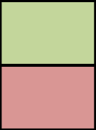
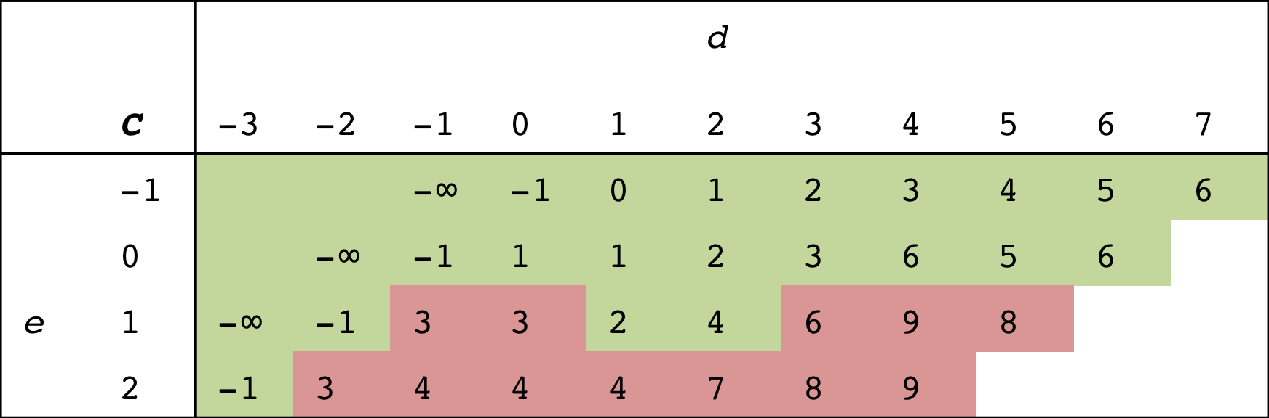
 |  | 0 | 1 | 2 | 3 | 4 | 5 | 6 | 7 | 8 | 9
 | M | - | A | G | G | T | A | T | C | G | C
0 | - | 0 | 0 | 0 | 0 | 0 | 0 | 0 | 0 | 0 | 0
1 | A | 1 | 0 | 1 | 1 | 1 | 0 | 1 | 1 | 1 | 1
2 | T | 2 | 1 | 1 | 2 | 1 | 1 | 0 | 1 | 2 | 2
3 | G | 3 | 2 | 1 | 1 | 2 | 2 | 1 | 1 | 1 | 2
4 | G | 4 | 3 | 2 | 1 | 2 | 3 | 2 | 2 | 1 | 2
5 | C | 5 | 4 | 3 | 2 | 2 | 3 | 3 | 2 | 2 | 1
How do we exploit this property in the alternative representation?
Previous sequence: ATGGC
New sequence: ATTAA
LCP: 2
Traditional dynamic programming table
Can reuse
Need to recompute
O(k) time to find starting point in table.
Alternate dynamic programming table

Slide 34
Proceed downwards along anti-diagonal until we find the first the cell where C(e, d) − d > LCP.
Notes:
----- Meeting Notes (5/9/14 15:09) -----
Put formula in there

Slide 36
Notes:
----- Meeting Notes (5/9/14 15:09) -----
Put proof

Slide 37
O(k + n) work to reuse previous matrix.

Slide 38
X 100,000,000
Part 2: Multi-core clustering
Proposed work:
Recruit sequences to cluster center using multiple cores.

Slide 39
1. Select a cluster center.
3. Repeat until no more
sequences remain.
2. Recruit sequences to center.
Center:
CATGCTGCCTCCCGTAGGAGGTGGGCTTCCTC
CATGCTGCCTC..GCTTCCTC
CATGTTGCCTC..GCTTCCTC
CATGTTGCCTC..GCTTCCTC
CATTTTGCCTC..GCTTTTTC
CATTTTGCCTC..GCTTTTTC
CATTTTGCCTC..GCTTTTTC
CGTGTTGCCTC..GCTTCCTC
CCTGTTGCCTC..GCTTCCTC
Sequences:

Slide 40
1. Select a cluster center.
3. Repeat until no more
sequences remain.
2. Recruit sequences to center.
Center:
CATGCTGCCTCCCGTAGGAGGTGGGCTTCCTC
CATGCTGCCTC..GCTTCCTC
CATGTTGCCTC..GCTTCCTC
CATGTTGCCTC..GCTTCCTC
CATTTTGCCTC..GCTTTTTC
CATTTTGCCTC..GCTTTTTC
CATTTTGCCTC..GCTTTTTC
CGTGTTGCCTC..GCTTCCTC
CCTGTTGCCTC..GCTTCCTC
Sequences:

Slide 41
1. Select a cluster center.
3. Repeat until no more
sequences remain.
2. Recruit sequences to center.
Center:
CATGCTGCCTCCCGTAGGAGGTGGGCTTCCTC
CATGCTGCCTC..GCTTCCTC
CATGTTGCCTC..GCTTCCTC
CATGTTGCCTC..GCTTCCTC
CATTTTGCCTC..GCTTTTTC
CATTTTGCCTC..GCTTTTTC
CATTTTGCCTC..GCTTTTTC
CGTGTTGCCTC..GCTTCCTC
CCTGTTGCCTC..GCTTCCTC
Sequences:

Slide 42
1. Select a cluster center.
3. Repeat until no more
sequences remain.
2. Recruit sequences to center.
Center:
CATGCTGCCTCCCGTAGGAGGTGGGCTTCCTC
CATGCTGCCTC..GCTTCCTC
CATGTTGCCTC..GCTTCCTC
CATGTTGCCTC..GCTTCCTC
CATTTTGCCTC..GCTTTTTC
CATTTTGCCTC..GCTTTTTC
CATTTTGCCTC..GCTTTTTC
CGTGTTGCCTC..GCTTCCTC
CCTGTTGCCTC..GCTTCCTC
How can we speed this up with multiple machines?
Sequences:
Notes:
And it goes on.

Slide 43
1. Select a cluster center.
3. Repeat until no more
sequences remain.
2. Recruit sequences to center.
Center:
CATGCTGCCTCCCGTAGGAGGTGGGCTTCCTC
CATGCTGCCTC..GCTTCCTC
CATGTTGCCTC..GCTTCCTC
CATGTTGCCTC..GCTTCCTC
CATTTTGCCTC..GCTTTTTC
CATTTTGCCTC..GCTTTTTC
CATTTTGCCTC..GCTTTTTC
CGTGTTGCCTC..GCTTCCTC
CCTGTTGCCTC..GCTTCCTC
Sequences:

Slide 44
1. Select a cluster center.
3. Repeat until no more
sequences remain.
2. Recruit sequences to center.
Center:
CATGCTGCCTCCCGTAGGAGGTGGGCTTCCTC
CATGCTGCCTC..GCTTCCTC
CATGTTGCCTC..GCTTCCTC
CATGTTGCCTC..GCTTCCTC
CATTTTGCCTC..GCTTTTTC
CATTTTGCCTC..GCTTTTTC
CATTTTGCCTC..GCTTTTTC
CGTGTTGCCTC..GCTTCCTC
CCTGTTGCCTC..GCTTCCTC
Sequences:

Slide 45
1. Select a cluster center.
3. Repeat until no more
sequences remain.
2. Recruit sequences to center.
Center:
CATGCTGCCTCCCGTAGGAGGTGGGCTTCCTC
CATGCTGCCTC..GCTTCCTC
CATGTTGCCTC..GCTTCCTC
CATGTTGCCTC..GCTTCCTC
CATTTTGCCTC..GCTTTTTC
CATTTTGCCTC..GCTTTTTC
CATTTTGCCTC..GCTTTTTC
CGTGTTGCCTC..GCTTCCTC
CCTGTTGCCTC..GCTTCCTC
Sequences:

Slide 46
Notes:
Quasi-linear speedup.
1.5x faster when doubling the threads

Slide 47
Sorted sequences create an implicit trie data structure.
Adjacent sequences sharing a common prefix to speed up edit distance computation.
CTG…
AT
ATGCTGCCTC..GCTTCCTC
ATGTTGCCTC..GCTTCCTC
ATGTTGCCTC..GCTTCCTC
ATGTTGCCTC..GCTTCCTC
ATTTTGCCTC..GCTTTTTC
ATTTTGCCTC..GCTTTTTC
ATTTTGCCTC..GCTTTTTC
CTGTTGCCTC..GCTTCCTC
TT…
G
TTG…
CTG…
Trie length: Sum of all edge lengths

Slide 48
Split the amount of potential work (characters we need to examine in the trie).
This is done by dividing the trie length by the number of threads.
Example:
AAAAAAAAAA
AAAAAAAAAA
AAAAAAAAAA
AAAAAAAAAA
AAAAAAAAAA
AAAAAAAAAA
AAAAAAAAAA
CCCCCCCCCC
GGGGGGGGGG
TTTTTTTTTT
Trie
length
AAAAAAAAAA
AAAAAAAAAA
AAAAAAAAAA
AAAAAAAAAA
AAAAAAAAAA
AAAAAAAAAA
AAAAAAAAAA
CCCCCCCCCC
GGGGGGGGGG
TTTTTTTTTT
Trie
length
10
20
40
20
Naïve
Work-based

Slide 49
Using 32 threads, work-based split reduces worst case work load by 8%.
Notes:
Future work involves actually implementing this.

Slide 50
Part 3: Ambiguous assignment
?
Proposed work:
Evaluate different strategies for assigning ambiguous reads.

Slide 51

Random
Uniquely alignable reads only
?
Flip a coin
Assign reads based on
proportion of unique reads
Fractional counts
0.5
0.5
66%
33%
http://www.psdgraphics.com/file/recycling-bin-icon.jpg

Slide 52
Preliminary Experiment
Greengenes (97% OTU database):
99,322 sequences
Input:
100 reads drawn from database (100bp w/ 1% error)
Methods:
Find all alignments of read -> OTU centers.
Results:
7,399 OTUs found (3 mismatches)
659 OTUS found (1 mismatch)
Notes:
Next steps.

Slide 53
Part I: Fast k-difference alignment
X 100,000,000
Part 2: Multi-core clustering
Part 3: Ambiguous assignment
?

Slide 54
Hidden

Slide 55
Acknowledgements
Committee
Mihai Pop
Héctor Corrada Bravo
Atif Memon
Pop lab
Irina Astrovskaya
Lee Mendelowitz
Joseph Paulson
Chengxi Ye
Senthil Kumar
Mathieu Almeida
Jeremy Selengut
Victoria Cepeda
NBACC
Sergey Koren
Todd Treangen
CBCB
Mike Cummings
Steve Mount
Sridhar Hannenhalli
Ted Gibbons
Derrick Wood
Adam Bazinet
Leonid Sukharnikov
Justin Malin
Avinash Sahu
BYOB
…
NSF
NIH
Former members
MohammadReza Ghodsi
Dan Sommer
Henry Lin
Bo Liu
Bravo Lab
Kwame Okrah
Joyce Hsiao
Wikum Dinalankara
Hisham Talukder

Slide 56
Cluster validation
External: compare with “true” partitions and labels.
Counting pairs: given partitions P1 and P2
N11 - # pairs of data points that are in the same cluster in P1 and P2
N01 - # pairs of data points that are in the same cluster in P2, but not P1
N10 - # pairs of data points that are in the same cluster in P1, but not p2
N00 - # pairs of data points that are not in the same cluster in both P1 and P2
Rand
N00 + N11 / (N11 + N01 + N10 + N00)
Jaccard
Intersection of two sets / union of two sets.
N11 / (N11 + N01 + N10)
Entropy
Normalized Mutual Information
Internal: compare with intrinsic properties of the cluster.
Sum of squared error

Slide 57
LCE in constant time
Create the GST corresponding to S1 and S2.
Process the GST so that it can do constant time LCA queries; this requires time O(n).
Depth first traversal of the general tree to assign depth-first search numbers to the nodes.
Find the lca of the two leaves corresponding to the suffixes S1[i] and S2[j]. The string depth of this node gives the longest common extension for the pair (i,j); this requires constant time per query.

Slide 58
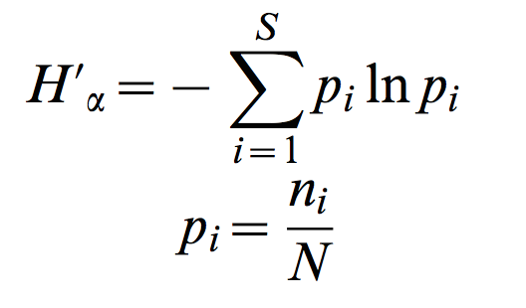
Measuring Diversity
Alpha-diversity
Shannon’s index

